Slide 1
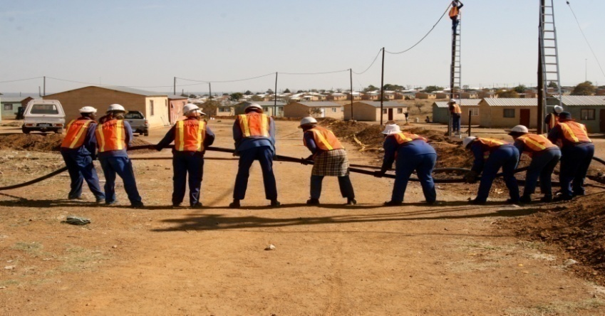
Expanded Public Works Programme EPWP 4rd Summit Commission 4

Slide 2
Presentation Outline
Introduction
Information to be reported beyond figures
Data Process Flow
Ownership of Data
Strategies to improve Auditing Compliance
Notes:
Scene setting:
SWOT analysis of the current the EPWP M&E?

Slide 3
Human Resource for Commission Four: EPWP Management Information Needs
Responsibility | Responsible Person | Name of Institution
Facilitator | Mr M Gomba | Department of Public Works Roads and Infrastructure: Limpopo Province
Facilitator | Ms ZN Mdakane | Department of Public Works Roads and Transport: Mpumalanga Province
Scribe | Ms N Manyisane | National Department of Public Works
Scribe | Mr Mzi Gusha | National Department of Public Works
Resource Person | Ms K Zantsi | National Department of Public Works
Rapporteur | Ms ZN Mdakane | Department of Public Works Roads and Transport: Mpumalanga Province
Notes:
Scene setting:
SWOT analysis of the current the EPWP M&E?

Slide 4
Introduction
EPWP needs good quality data which is correct, complete and consistent
Correct data is accurate and reflects what actually happened
Complete data has no data gaps that means all required fields are reported
Consistent data has no unexplained variations
Data Management systems in place must be reliable, effective and efficient
EPWP should report beyond the numbers and have portfolio of evidence to show case how the lives of participants have changed
Notes:
Scene setting:
SWOT analysis of the current the EPWP M&E?

Slide 5
Information to be Reported beyond Figures
Issue | Action | Responsibility | Time Frames
1. Reporting beyond numbers: what type of indicators are important for reporting? | Conducting baseline assessment, report impact (tracking of participants) Uploading trained participants. Report and keep records of training and capacity building of participants. M and E should report the actual number of participants per Demographics( ID verification) Reporting the type of assets and services provided. Outputs should be made a compulsory field. | Public bodies National M and E Public bodies National M&E | Quarterly Quarterly Monthly 2015/16
Notes:
Scene setting:
SWOT analysis of the current the EPWP M&E?

Slide 6
Information to be Reported beyond Figures
Issue | Action | Responsibility | Time Frames
Reporting beyond numbers: what type of indicators are important for reporting? | Completed projects should be profiled and archived Develop sector specific reporting templates and the indicators should be aligned to the sector. | National M&E , Public bodies | On-going
Notes:
Scene setting:
SWOT analysis of the current the EPWP M&E?

Slide 7
Data Process Flow
Issue | Action | Responsibility | Time Frames
2. Data process flow –which model should be adopted data integrity and ownership of data? | Establishment of M&E units in provinces. Capacity for data management and required resources to be in place Capacity for data collection and verification to be in place Have stake holder engagement forums to give feedback to public bodies on all non-compliant projects Off-line template should be utilised | Coordinating departments | 2015/16 3 weeks after system closure
Notes:
Scene setting:
SWOT analysis of the current the EPWP M&E?

Slide 8
Data Process Flow
COORDINATING DEPARTMENT: MONITORING SECTION
Data collection on site
Data processing for capturing
Data verification
Submission of data to data management section
DATA MANAGEMENT SECTION
Allocation of data to data management coordinators per sector
Check for completeness and accuracy of data
DATA MANAGEMENT SECTION
Allocation of data to data capturers (per Municipality, Programme, Department)
Record all projects allocated
Authorise for capturing
DATA MANAGEMENT SECTION
Monitor Capturing
Track Capturing status
Report progress weekly.
Ensure filing of captured projects and keeping project profiles
DATA MANAGEMENT SECTION
Compile progress reports on data captured (Monthly):
Reconciliation of captured data against data submitted/collected electronically and manually.
DATA MANAGEMENT SECTION
Coordinate stakeholder engagement forums to discuss non-compliant data and also data which has been captured
Update project data on the system
DATA MANAGEMENT SECTION
Provincial cut-off date for capturing by the 10th of the month following the end of the quarter.
Validation of unpublished report up until system closure
Receiving raw data and dealing with all non-compliant data
Signing -off of provincial unpublished report to NDPW
EVALUATION SECTION
Conduct quarterly data quality assessments
Checking for compliance to the Ministerial Determination and audit requirements
Utilising sector forums to give feedback to stakeholders
Developing an action plan to deal with non-compliant projects
Notes:
Scene setting:
SWOT analysis of the current the EPWP M&E?

Slide 9
Data Process Flow
IMPLEMENTING BODIES
Data collection on site
Data processing for capturing
DATA CAPTURING
Check for completeness and accuracy of data
Data capturing
DATA VERIFICATION
Verification of data in the system and analyse the information in the system
DATA VALIDATION
M&E NDPW validates information in the system
DRAFT ANNEXURES AND RAW DATA
Correct all non-compliant projects and discrepancies
SIGN OFF AND RESUBMISSION TO NDPW
Notes:
Scene setting:
SWOT analysis of the current the EPWP M&E?

Slide 10
Ownership of Data
Issue | Action | Responsibility | Time Frames
3. Ownership of data – who is responsible for what and how to ensure this ownership takes place? | Ownership lies with the public bodies Signing off of reports loaded on the system NDPW should not accept data which is not signed off Utilise 5% of the incentive grant to close the gap of reporting capacity | Public body (HoD and MM ) | Quarterly
Notes:
Scene setting:
SWOT analysis of the current the EPWP M&E?

Slide 11
Improving EPWP Data Gaps
Issue | Action | Responsibility | Time Frames
4. How to improve the data gaps that exist in the EPWP reports? | Decentralisation of data capturing is recommended to improve ownership of data and increased accountability System should flag participants who leave the programme Provinces to channel the budget for appointment of consultants to capacitate municipalities to report on their own | National M&E | On- going
Notes:
Scene setting:
SWOT analysis of the current the EPWP M&E?

Slide 12
Strategies to Improve Auditing Compliance
Issue | Action | Responsibility | Time Frames
5. What strategies should be used to improve auditing processes in EPWP? | Implementing bodies should keep records and all source documents Certified ID copies Contracts with participants Attendance registers Payments registers Include source documents in the appointments of consultants Do monthly reporting by making it a condition that contractors submit data with their monthly payment certificates | Public bodies | Monthly
Notes:
Scene setting:
SWOT analysis of the current the EPWP M&E?

Slide 13
Strategies to Improve Auditing Compliance
Issue | Action | Responsibility | Time Frames
5. What strategies should be used to improve auditing processes in EPWP? | Link EPWP reporting system with Home Affairs for ID verification Conduct quarterly data quality surveys Communicate findings to all stakeholders Develop an action plan to address all non-compliance issues | NDPW M&E NDPW ,Coordinating Departments & Public Bodies | On-going Quarterly
Notes:
Scene setting:
SWOT analysis of the current the EPWP M&E?

Slide 14
Conclusion
“When the Government has the right people, the right systems and the right intentions, many good things can happen. The trick is knowing which ones they are” Alan Ehrenhalt
Notes:
Scene setting:
SWOT analysis of the current the EPWP M&E?

